Slide 1

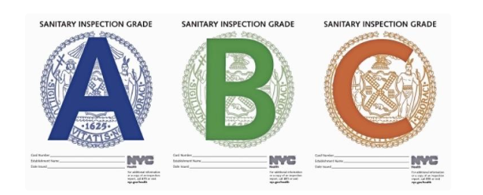
NYC Restaurants Inspection Results
2021 - 2024
Presented by
Jose Villa, Eilani Aguilar, Kimberly Cruz, Scott Bond, Nancy Rosa

Slide 2
Agenda
Introduction
In what borough are Violations most likely to be found?
Do different cuisines drive more violations?
YoY Seasonal Change in Restaurant Violations
Conclusion and Closing Statements

Slide 3
INTRODUCTION
This dataset contains inspection results for New York City restaurants and college cafeterias (referred to as restaurants) from up to three years before the most recent inspection.
Its main goal is to offer insights into recent inspections. Restaurants that have closed are removed from the dataset, making it unsuitable for conducting historical comparisons between past and current inspection data.
Data range Dec 2021- June 2024
NYC Open Data

Slide 4
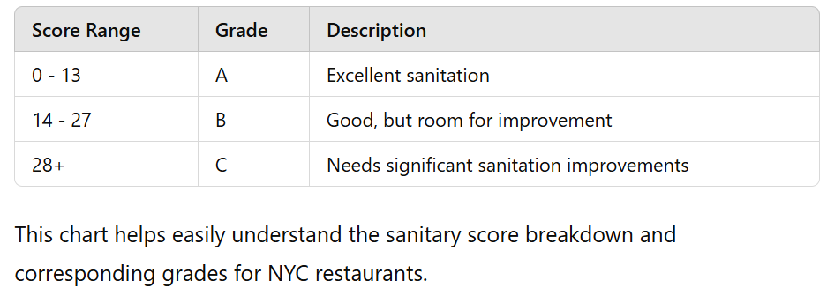
UNDERSTANDING LETTER GRADING SYSTEM

Slide 5
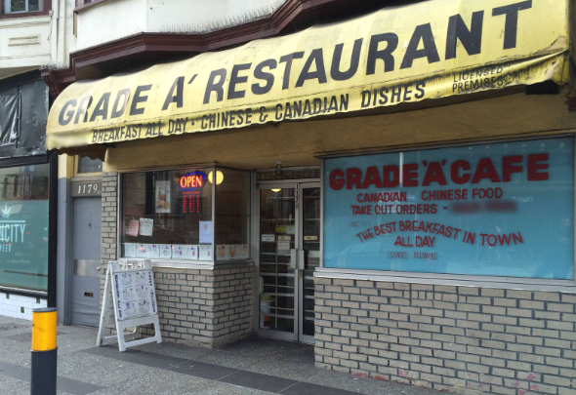
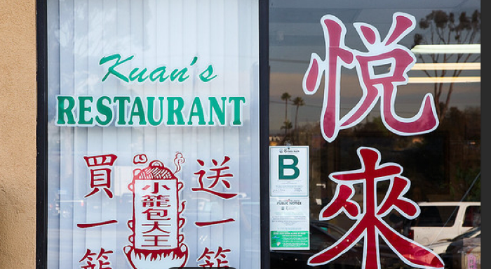
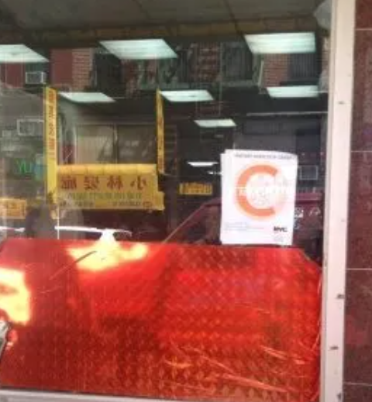
Example of the Grades being shown

Slide 6
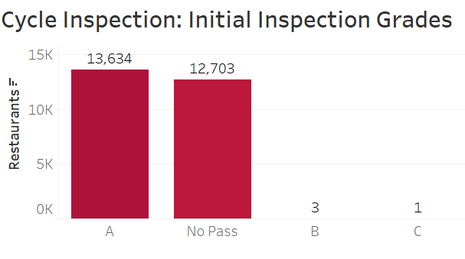
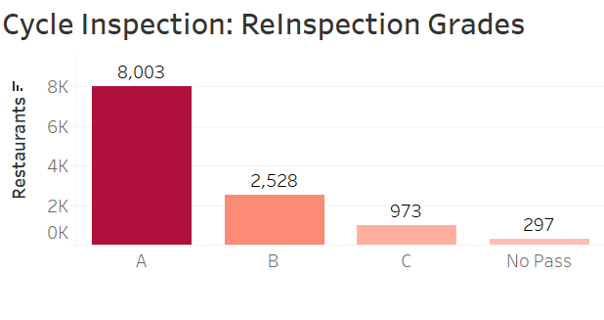
TYPES OF INSPECTIONS
27 type of inspection results are included in the dataset
Not every inspection is a “gradable” inspection
Inspection Cycle inspections are when restaurants receive a new/updated grade
Re-inspection follows a failed initial inspection
Closure after failed Re-inspection

Slide 7
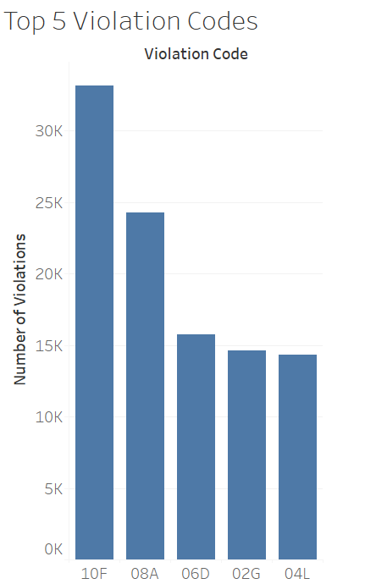
TYPES OF VIOLATIONS
Each violation is associated with a range of points depending on the type and extent of the violation, and the risk it poses to the public
Violation codes
10F : Non-food contact surface improperly constructed
08A: Facility not vermin proof
06D: Food contact surface not washed, rinsed or sanitized after each use and following any activity when contaminate
02G: Cold food item held above 41°F, except during necessary preparation
04L: Evidence of mice or live mice present in facility’s food and/or non-food areas
These are the
Notes:
Could break into two slides
Explain codes by changing the graph or on the slide

Slide 8
Critical Flags in Restaurant Violations
Critical flags are major violations that can result in foodborne illnesses.
Some examples of these kinds of violations are:
Food not cooked or held to a proper temperature
Improper food handling or preparation
Evidence of rats, mice, roaches or flies
Certain facilities not provided for employees
Unlabeled food, equipment, and cleaning supplies
Note: General flags and or violations are focused more on cleanliness, lighting, structural issues, and improper signage

Slide 9
In what borough are Violations most likely to be found?

Slide 10
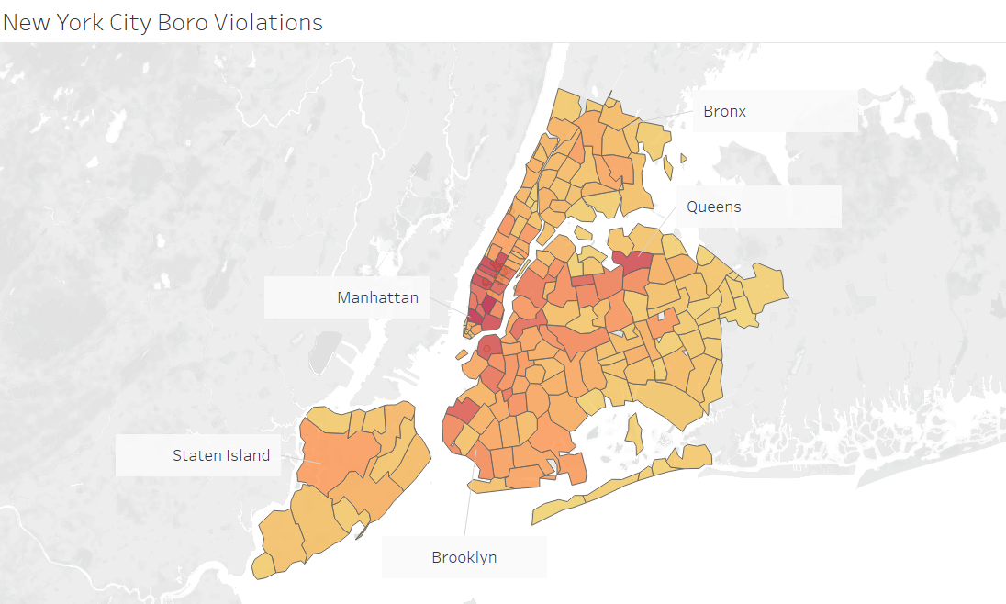
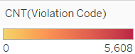
A heat map of where restaurant violations are taken place in NYC
Notes:
See if we can add groups for each Boro or make the lines more defined to point to each Boro

Slide 11
In what borough are critical flags most likely to be found?

Slide 12
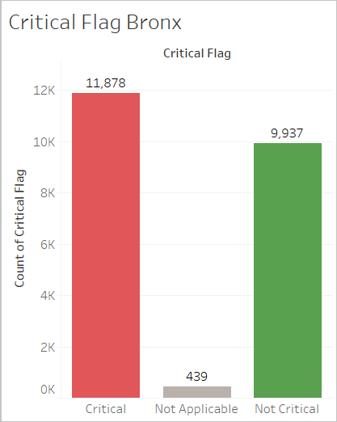
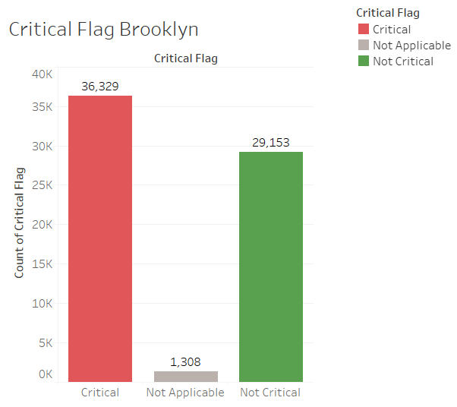
Count of Critical flags taken place in each of the five boros in NYC
Notes:
Explain the what a critical flag is, a one sentence description in each slide

Slide 13
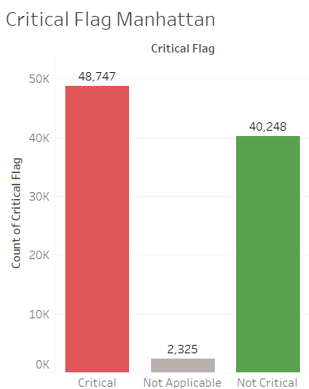
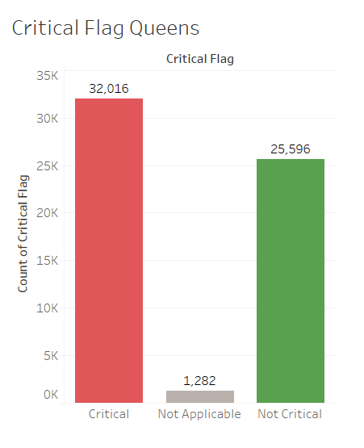
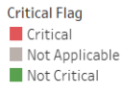
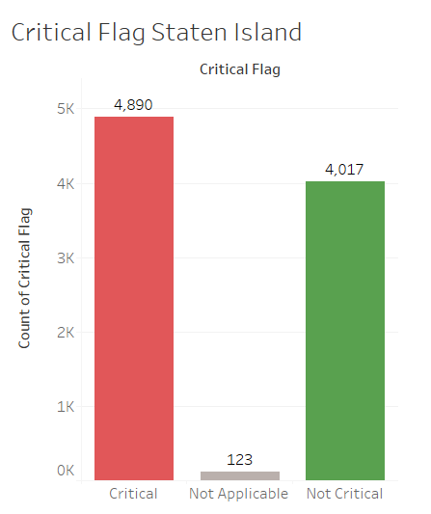
Count of Critical flags taken place in each of the five boros in NYC

Slide 14
Do different cuisines drive more violations?

Slide 15
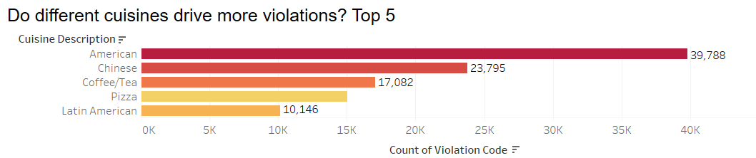
Top 5 cuisines based on restaurant violations

Slide 16
YoY Seasonal Change in Restaurant Violations

Slide 17
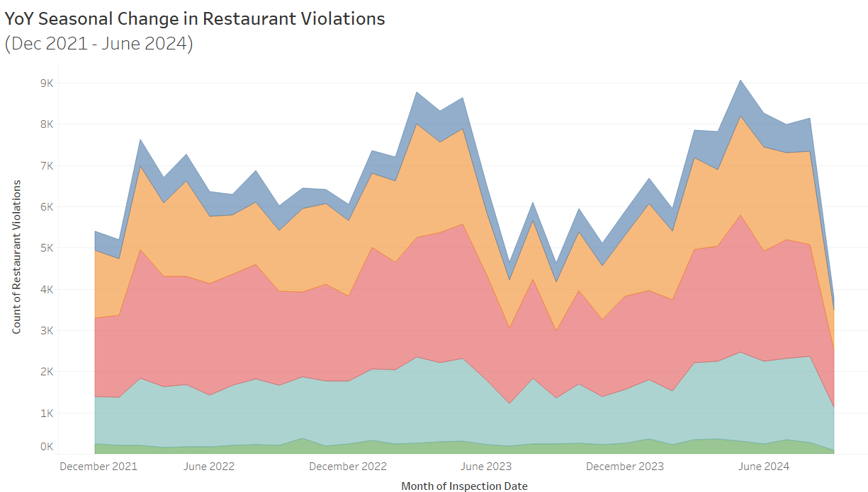
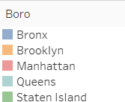
Counts of restaurant violations over the months in the 5 boros in NYC
Notes:
The seasonal change in restaurant violations showed spring to have the highest peaks in restaurant violations with fall being the least likely to get violations.

Slide 18
Conclusion and Closing Statements

Slide 19
Manhattan has the highest concentration of restaurant violations and critical flags.
Staten Island yield the least restaurant violations during seasonal changes.
American cuisine yielded the most violations.
Conclusion

Slide 20
Recommendations
EcoSure to provide etiquette guidelines to train restaurant staff on properly maintaining food safety.
Staff should be trained based on the top 5 restaurant violation codes to avoid common sanitary violations, such as food contact surfaces not being washed, rinsed, or sanitized.
Chimichurri (Argentinian) brings the least violations.

Slide 21


Slide 22
Sources
DOHMH New York City Restaurant Inspection Results | NYC Open Data (cityofnewyork.us)
common-violations.pdf (nyc.gov)
EcoSure Food Safety | Food Service Food Safety & Brand Protection | Ecolab
Notes:
Practice presenting, 15 minute time limit presentation

